Slide 1
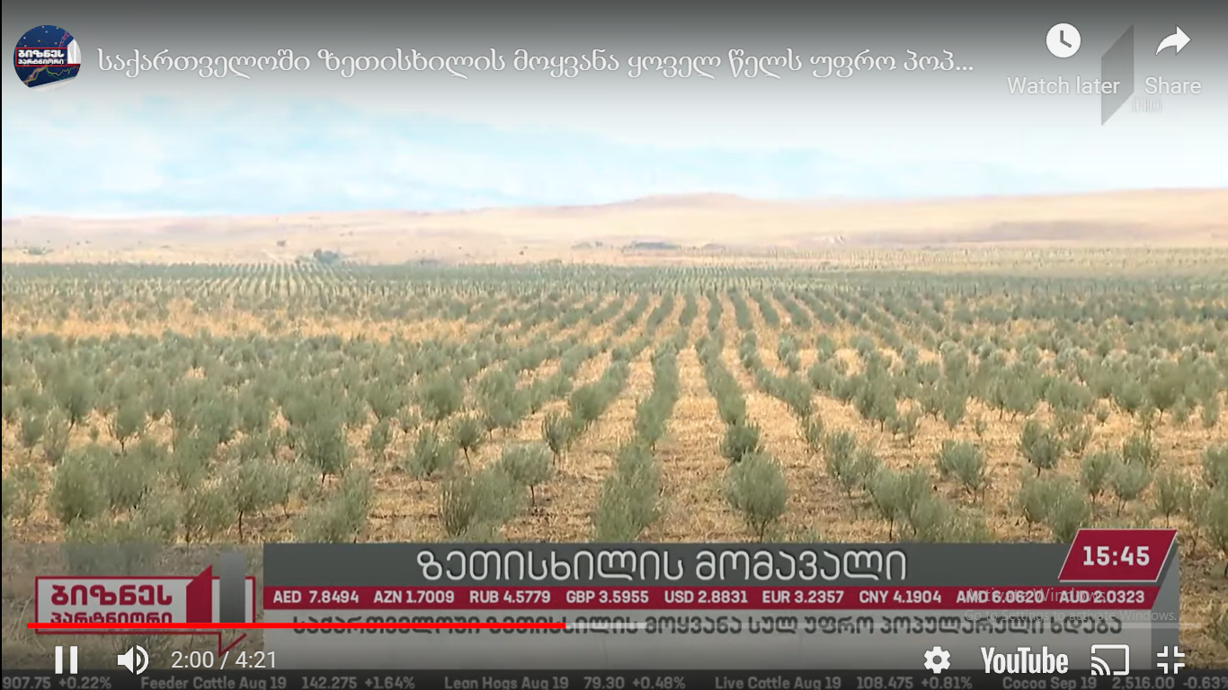
Importances and prospectives of olive (Olea europaea s.l) culture in Georgia
Zviad Bobokashvili – Head of department of fruit crop research growing, LEPL Scientific-Research Centre of Agriculture Ministry of Agriculture Georgia, PhD, associated professor,
Ellene Maghlakelidze - Chief Specialist department of fruit growing, LEPL Scientific-Research Centre of Agriculture Ministry of Agriculture Georgia, PhD.

Slide 2
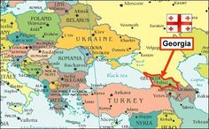
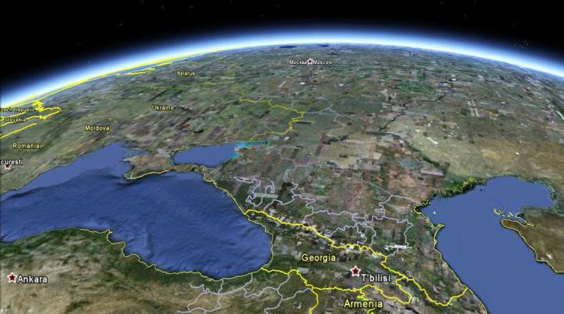
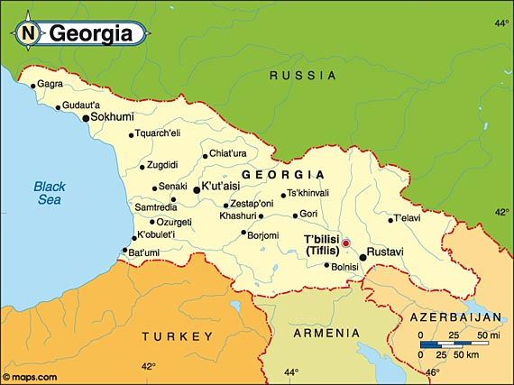
Georgia
Geographic location of Georgia
Map of Georgia
The area of Georgia is 69,700 km².
Country Rich with renewable water resources
33 % of territory is covered by forests
Georgia is located in the mountainous South Caucasus, between of the Black sea and Caspian sea.
Country has very varied topographies and soils and lies between of major and minor Caucasus mountains.

Slide 3
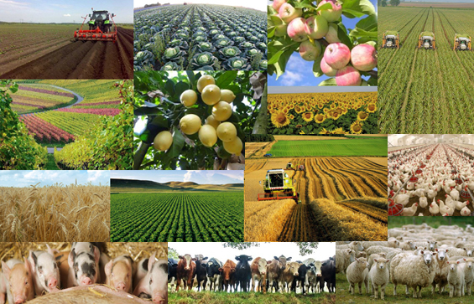
Agriculture of Georgia
Traditionally, Georgia has rich agricultural History and traditions
There are 12 different climate zones and 49 soil types.
They tend to be quite fertile and rather easily handled.
Agriculture accounts for 8.3 - 9.2% of GDP and 16-17.5% of the trade volume.
A long Tradition of Wine, Citrus, Grape, Tea, Nuts, Fruits and Vegetables production.
Georgia is considered included into IV group of Plants origin (Vavilov) – Southwest Asia

Slide 4
perennial Crop Production in Georgia - 2015-2020
The fruit production is varies 190 000– 230 000 Mt per year
Total Grape production is about 250 000 – 320 000 Mt per annum
Citrus production 50 000 – 80 000 Mt
The basic perennial fruits are : Apple, Hazelnut, Peach, Plum and persimmon
The major citrus is Mandarins.
Export products: Hazelnut, Peach, Persimmon, Apple

Slide 5
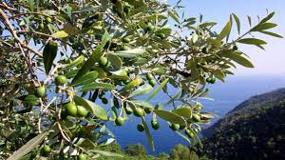
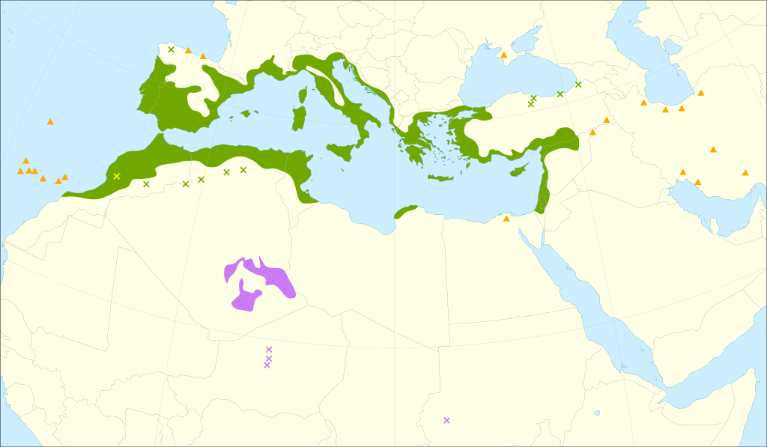
History and distribution of olive culture in Georgia
There are proposals that Olives was relicted species for south west regions of Georgia, Some wildered Olives evidences can found in forests with Laurels (Laurus nobilis) In South –West Georgia and in Abkhasia
Accoring of Bible – Noa has distributed Olives in place between of Armenia and Georgia
Hovewer first historical data regarding of olives presence in Georgia described I-II century on new era – according of researchers it considered that it was introduced in Country probably by greek colonists in Black see Coast
(I. Javakhishvili, 1956)
Some literature sources indicated that olive plants was planted near Tbilisi area in VI-VII centuries
Famous Georgian Geographer Vakhushti Batonishvili (1745,1750) wrote that Olive was planted in various areas of Georgia
According of XVIII Year historical sources (Guldenshtedt, 1775; 1783) olive trees was common in Ajara( Batumi and Gonio) area.

Slide 6
Historical overview and distribution of olive culture in Georgia -2
According of XIX century data -Near Urta ( Zugdidi, West Georgia) Olive trees was common.
Also separate old Plants could be found in Chokhatauri, Senaki, Khobi, Terjola, Akhali Athoni, Gagra, Gurjaani and in Sighnaghi (Bodbe) districts (Different regions of Georgia).
At the end of XIX century and beginning of the 20th century, olive growing starts intensively practiced in Georgia near of Balck see (Akhali Atoni church). Several hundred tons of fruits were harvested annually, to produce Olive oils, canned food and marinades.
There been described the local varieties of olives: "Oturi", "Butko" (Canning direction) "Gorvala" and others.
In Tbilisi, was very popular olive variety variety "Tbilisuri", which is only available now in Abkhazia.
According of Arch. Lamberti 756 Year was very frosty winter, when black see was frozen near kokheti – looks like it was has devastating effects of olive production in georgia.
After cold winters of 1930th olives became rare crop to the Georgia.
According of former SU planning economy Georgia began to cultivate other crops - In particular, tea and citrus fruits in western Georgia and apples and grape - Eastern Georgia.

Slide 7
Olives in Diet and medicine of Georgia
Olives is used In Georgian Cousine Basically as olive oils in various types of dishes like salads, With eggplants and soupes
Intensively used pickled black and green olives
According of old medical Books (Karabadini) it is used as ingredients of various recipy for medical care.

Slide 8
constrains and reasons of decline of olive culture
Olive crops has specific requirement to winter hardiness ( -10 -15 C) this is warm climate fruits.
According of data Arch. Lamberti (1655), In The VIII century (756 Year) in Georgia was very frosty winter, when black see was frozen near Kolkheti – lookslike it was has devastating effects of olive trees in Georgia for this period.
End of XIX century was described another cold wawe in East Georgia (1897 Y). In Tbilisi was – 22- 24 C)
After cold winters of 1930th olives became rare crop to the Georgia.
In the 1950-1951 Winter frost (bellow of -10-12 C) In west Georgia as well very negatively effects on existing single tree presence in Country.
But Main reason was – Soviet Union Planning economy, where was directed and focused on to cultivate In Georgia other crops - In particular, tea and citrus fruits in western Georgia, and apples and grape in Eastern Georgia.

Slide 9
Proposal areas for olive production In Georgia
Microzones in Kakheti region ( Gurjaani, Sighnaghi, Lagodekhi, Kvareli)
Black see coast area (Guria – Ozurgeti, Lanchkhuti, Samegrelo – Khobi, Senaki,Zugdidi
Some districts of Imereti (Baghdati, Samtredia, Terjola, Vani)
Kvemo Kartli (Marneuli and Tbilisi around)
Microzones should Based on data on soil – no acid soils, no wet lands,
Based on climatical analizis – no frost evidences bellow -12-15

Slide 10
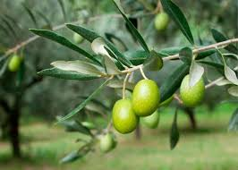
Production of olives – current situation and trends
Rehabilitation and creating of olive production sector was started decade ago by initiative the company “Georgian Olive “ and “Georgian olive association” since 2010
Over than 1000 ha (2020 evaluation) of olive orchards was established in Country within of these year
Main production region is East - south of Kakheti (where is located 95 % of Olive production in Georgia)
The Basic variety is Gemlik, which is introduced from Turkey
Layout of orchards are varies: 6-8 meter per 4-5 meter
There are irrigated and rainfeed orchards
The adjusting agro technological, harvest and processing management aspects is main issues to overcome for sustain this very important industry

Slide 11
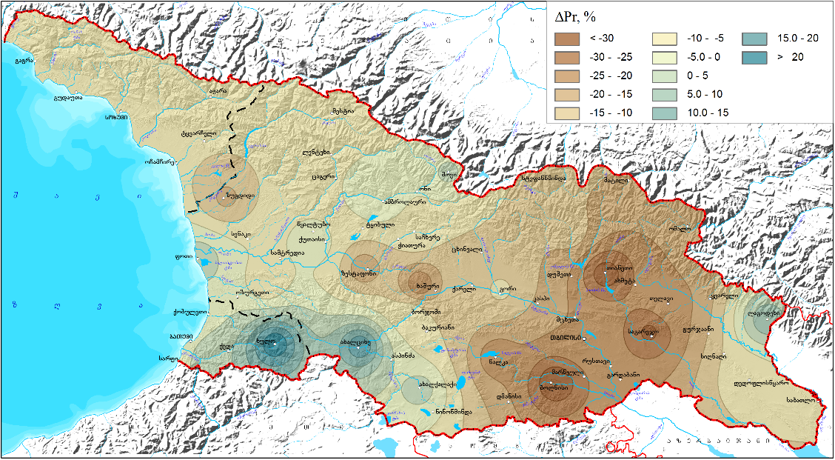
Olives and climate change effects
Climate change models (2041- 2070) and (2071-2100
Source: The National Environment Agency, 2020

Slide 12
Current changes in Climate (1986 –2015) VS (1956-1985) in Kakheti
The average temperature increased by 0.49-0.57 increased by 0.54 C in Kakheti.
The increase in average air temperatures mainly occurs in June-October.
And in November-December there is a slight decrease in average temperature.
Precipitation during the summer months was reduced by 20-25 mm
Annual precipitation is mostly reduced

Slide 13
Predicted changes in climate according to the forecast models (2041-2070) and (2071 -2100)
The first forecast period (2041–2070) is proposed that the annual precipitation in Kakheti decreased by 8%. There is a significant increase in precipitation in winter (by 15%), a decrease in the remaining three seasons, the maximum decrease will be observed in spring (by 21%).
The second forecast period (2071–2100), annual precipitation in Kakheti decreased by 19%. The reduction is especially significant in spring (28%) and autumn (16%). Growth only in summer (by 6%).
Source: The National Environment Agency, 2020

Slide 14
Proposal effects of climate change on olive production
Negative impacts
Lack of rainfall during the summer months will lead to water deficit of olive plantations, decreasing of olive quality and reduced yields.
The number of hail days will increase
Due to the change of temperature regime, the load of harmful pathogens will increase and consequently the need to use more integrated plant protection measures
Positive impact
The sum of active temperatures will increase - it will be possible to focus on the cultivation of high quality olive varieties
Critical winter temperatures will be reduced - it will be possible to appear new regions of olive production

Slide 15
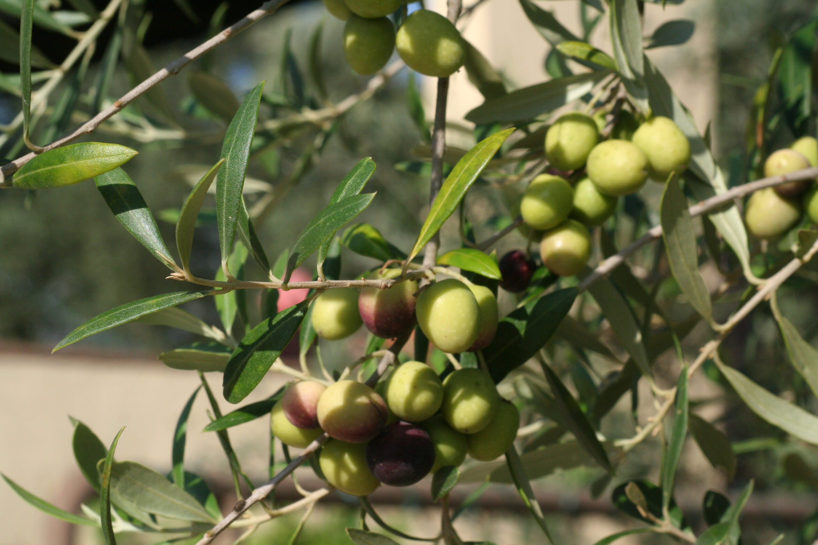
Direction of Strategy on climate change on olive production
MAJOR MEASURES
Facilitate the arrangement of water wells and irrigation systems to ensure drip irrigation in conditions of water shortage
Support for the use of prediction, diagnosis and meteorological monitoring tools for harmful pathogens
- Planting of windbreak lines
Strengthen insurance systems to reduce the negative effects of wind and MINOR MEASURES
- Improvement and adaptation of agro-technical measures - pruning, fertilization in lack of water
Study of mulching technologies - both organic and plastic mulch to maintain moisture in the soil;
Application of conservative agricultural principles
Research on the use of specialized preparates (caolin base) to prevent heat damage and facilitate their use

Slide 16
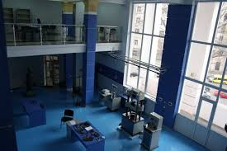
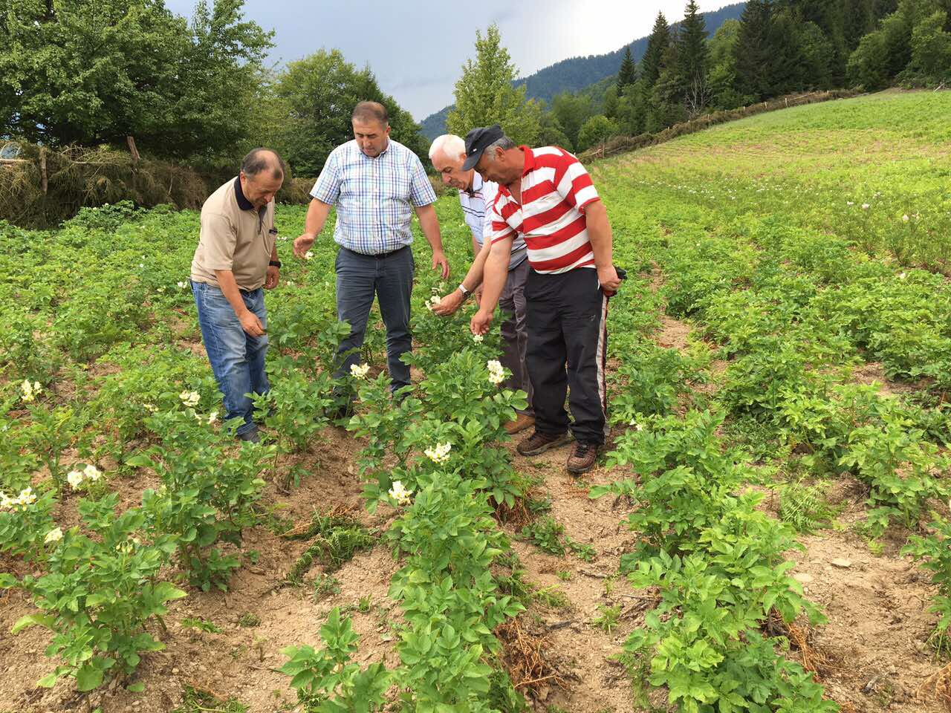
Agriculture scientific research center
Research organization on Olives
Was established 2014, Feb;
• Consists 14 Research departments;
• Covering all main sectors of Agriculture;
• 125 researcher and Specialists;
• 1 head office, 3 regional offices;
• Focused on strategic and Applied research in Agriculture
• Back research for ICC centers
• Training of trainers and Farmers

Slide 17
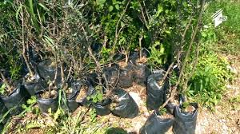
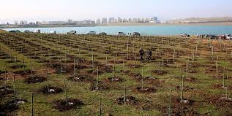
local research on Olives
Variety selection 1930 -1950 ( O. Tsulukidze, 1953; M. Ghlonti, 1960; M. Nizharadze, 1966)
Improving of variety selection and Propagation of olive plants ( G.Zenaishvili, L. Lasareishvili 1988; 1991)
Study of introduced italian olive varieties in 2010 – 2014 YY - Ghiachiolo, Leccino, Ascolano, Frontoyo and Corregiollo (Z.Bobokashvili; E. Maghlakelidze, 2014)

Slide 18
Georgian germplasm of olives
Unfortunately, the old varieties are no more exists, or is preserved in the form of separate trees.
Variety -"Tbilisuri". The origin is unknown. Found in New Athos, Sokhumi. (Western region of Georgia). It is also found in the form of unit trees in different regions of Georgia. The variety is characterized by resistance to pests and diseases. Tree is high - 8-10 m, develops wide, rounded, a well-drained, well-leafed exercise. Characterized by abundant and regular growing. The average yield of per tree is 40 kg. Flowering in the second half of May. It is self-fertile. The fruit is medium-sized, weighing 3-5 g, rounded oval, symmetrical. The skin of the fruit is soft; After ripening dark in color, with shiny skin. The fruits ripen in November. Ripe fruit contains 60,5-72% oil. Used for canning (marinade) and to get oil.
Variety – „Oturi”. The origin is unknown. Distributed in different regions of Georgia (New Athos, In Sukhumi, Terjola and Baghdad). The tree is characterized by rapid growth, usually is of medium height, develops a beautiful, open, strongly branched, often leafy exercise. Characterized by abundant and regular growing. Characterized by drought and frost resistance. Flowering time in late May. It is self-fertile. In the case of cross-fertilization, the yield increases significantly. Ripen in the second half of November. Fruit size is large - 9-14 g. oval, symmetrical. The skin of the fruit is soft, duke-blue in ripeness. Stone - small size. Oil content in the fruit - 65-68%. The fruit is best for both canning and oil.
Variety - “Tolgomuri” - originated in the Caucasus. It was named after the village of Artvin district from Tolgomi. Mostly found in New Athos (Western region of Georgia). The tree is of medium height, develops a deciduous, branched, slender trunk. Characterized by medium to regular growth.Less resistant to pests and diseases. Flowering time in late May. To get a high yield requires a pollinator.The fruit is large. weighing 5-7g, rounded-inverted ovate, asymmetrical. The skin of the ripe fruit is tender. Covered with black wax snowflake. The stone is large in size. The fruits ripen time is in early November. The fruit is suitable for both canning and oil production. Content of oil in the fruit 70%.

Slide 19
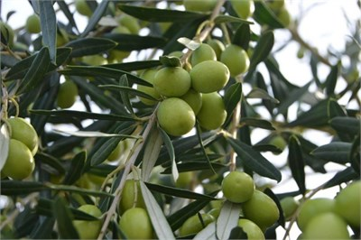
Olive Current Varieties in Georgia -Gemlik and Ayvalik
Origin : | Anatolia , TURKEY
Tree Features: | Medium growth
Fruit Size: | Medium
Fruit Shape : | Cilindrical to oval
Fruit Color | Black
Kernel | The kernels is medium size.
Oil content | Oil content 28 – 29 %
Flowering time: | Middle May – Beginning of June
Harvest Time | Harvest Novmber – December
Pollinators: | Ayvalik

Slide 20
Current directions on research of Olives
Search and finding of local varieties ("Tbilisuri", "Akhasheni", "Butko", etc.), Which were distinguished by good adaptability and cold hardiness
Evaluation of introduced varieties
Introducing new germplasm and study of its agronomical value & features
High density orchard possibility study – Arbequine and Coroneyki.
Technical assistance for olive nursery farm establishment, for propagation local cultivars and introduced tested varieties

Slide 21
Public MEnAG assistance to olive production

Slide 22
Acknowledgment
We are appreciated International Olive Council ( IOC) for great assistance and Special thanks to Mr. Abdellatif Ghedira (Executive Director _ of for kind support for our participation in the Important technical “Online Advanced Course on Olive Growing” held Nov, 2021
Special thanks to Mr. George Svanidze , for their great Initiative to rebuild Georgian Olive industry in XXI century
Thanks for Ministry of Environment and Agriculture Georgia –MoEA for possibility to participate in this meeting and funding ag research activities

Slide 23
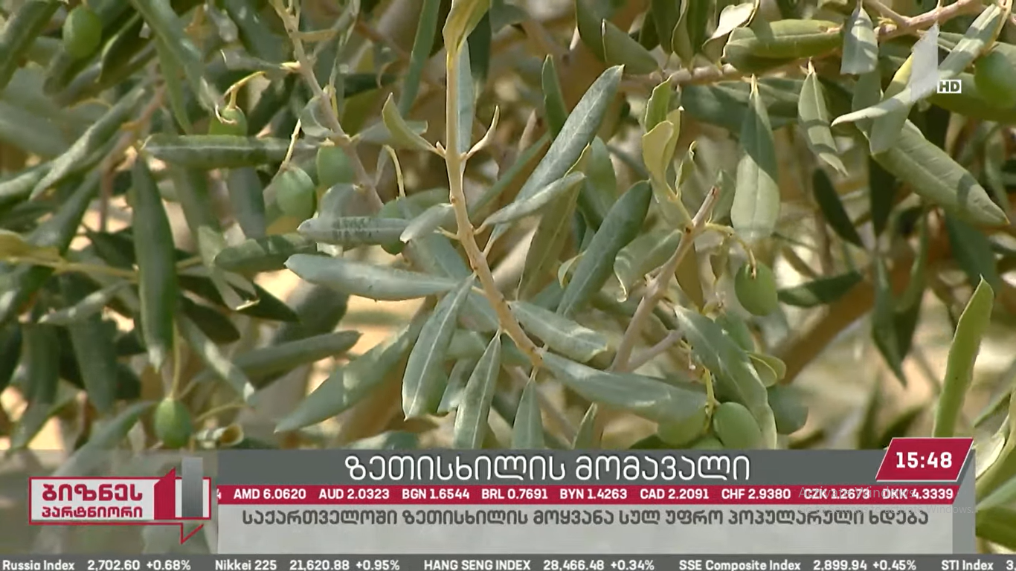
Thank you for attention !!!
Questions ???
Zviad Bobokashvili – Head of department of fruit crop research , LEPL Scientific-Research Centre of Agriculture Ministry of Agriculture Georgia, PhD, associated Professor,
Bobokashvili@Hotmail.com

Slide 24
Importances and prospectives of olive (Olea europaea s.l) culture in Georgia
Thank you for attention !!!
Questions ???
Zviad Bobokashvili – Head of department of fruit crop research , LEPL Scientific-Research Centre of Agriculture Ministry of Agriculture Georgia, PhD, associated Professor,
Bobokashvili@Hotmail.com

